Slide 1
Bare international analysis
Comprehensive Analysis and Insights

Slide 2
Overview of the Project:
. The project aims to evaluate the performance of Style Advisors using a comprehensive set of criteria. The evaluation data covers various aspects such as store ambiance, first impressions, discovery of customer needs, trial experience, and overall customer service. The primary focus is on understanding how well Style Advisors are performing and identifying areas for improvement.

Slide 3
Objectives of the Analysis:
Grade Performance Tiers: Sort store evaluations into clear categories—High, Average, Low, and Bottom—using structured scoring formulas.
Find Regional Leaders: Figure out which geographic zones are crushing their goals and which ones are falling behind.
Spot Operational Gaps: Break down specific criteria like store ambiance, staff recommendations, and closing techniques to see exactly where service breaks down.
Deliver Actionable Insights: Give management clear, practical recommendations backed by data to help improve trainin

Slide 4
Data Overview
multiple rows and columns.
Core Identification & Timing Fields: Columns like Evaluation_Date record when the store visit happened, while geographical fields like Zone (East, North, South, West) track regional placement.
Scoring & Performance Metrics: The primary metric is the Evaluation_Score, which measures overall store performance and serves as the baseline for sorting stores into performance tiers using grading logic.
Detailed Evaluation Criteria: Specific operational categories—such as STORE AMBIANCE, FIRST IMPRESSIONS, DISCOVERY, RECOMMENDATIONS, TRIAL EXPERIENCE & UPSELL, OBJECTION HANDLING, and CLOSURE & CARE—break down individual customer service touchpoints.
Calculated Helper Columns: Additional columns include our custom Grade classification (High, Average, Low, Bottom), allowing analysts to pivot and visualize performance distributions cleanly.

Slide 5
Performance Grading
Performance Tier | Score Range | Description / Status
High Performer | 90%to 100% | Exceptional service, exceeding expectations
Average Performer | 70% to 89% | Satisfactory service, meeting standard benchmarks
Low Performer | 50%to 69% | Below average service, requiring operational attention
Bottom Performer | 0.00%to 49% | Critical failure points, needing immediate corrective action

Slide 6
How Grades Were Assigned:
  We used Excel's logical IFS formula to evaluate each store's final percentage score automatically.
  For example, if a mystery shopper evaluation scored an 85%, the formula checked the scale, recognized it fell between 70% and 89.99%, and neatly assigned it the Average Performer tag. If a store scored a 92%, it was instantly categorized as a High Performer to help us track top-tier locations. If a score 59 % they give low performance.

Slide 7
Key observations from the pivot table
Pivot Table Structure: The pivot table aggregates store data by placing the Zone field in the rows and calculating the average of the Evaluation_Score in the values column.
Regional Score Hierarchy: The East zone achieves the highest average evaluation score among all regions, establishing itself as the top performer.
Baseline Stability: The remaining zones maintain relatively stable average scores that cluster closely together, indicating consistent baseline execution across most territories.
Averages vs. Distribution: While overall regional averages appear balanced, combining this pivot view with tier distributions reveals that mean scores can mask significant internal gaps between high- and low-performing stores.

Slide 8
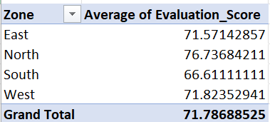
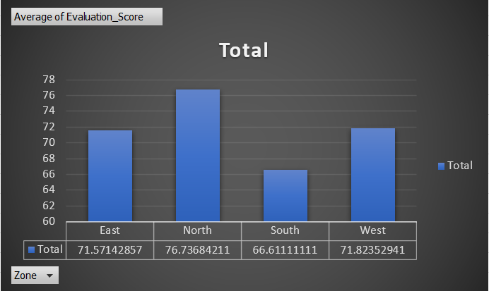
Pivot Table Analysis
Pivot table showing average Evaluation_Score by Zone

Slide 9
Region with the highest percentage highlighted
Steps to Find the Region with the Highest Percentage of High Performers
1. Create a Pivot Table: Show counts of each performance grade by Zone.
2. Calculate Percentage: For each zone, divide the number of High Performers by the total number of evaluations.
3. Identify Region: Find the zone with the highest percentage of High Performers.

Slide 10
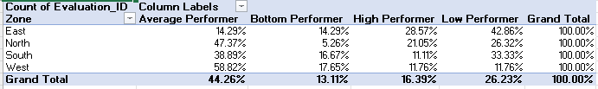

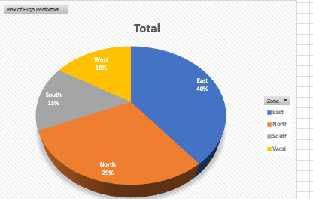
High Performer Analysis

Slide 11
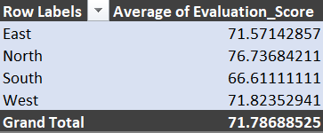
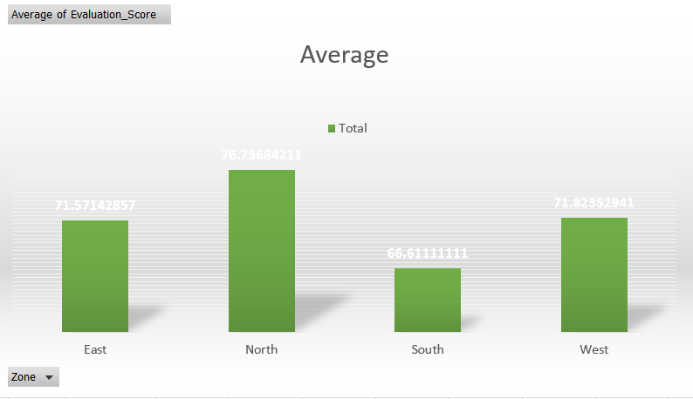
Visualizations
Average Evaluation Scores by Zone

Slide 12
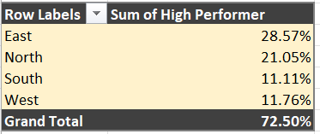
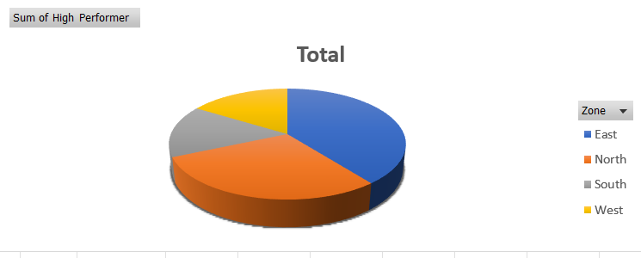
Percentage of High Performers by Region

Slide 13
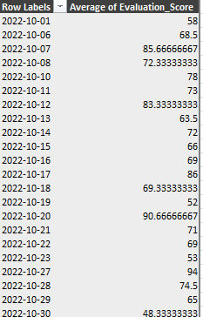
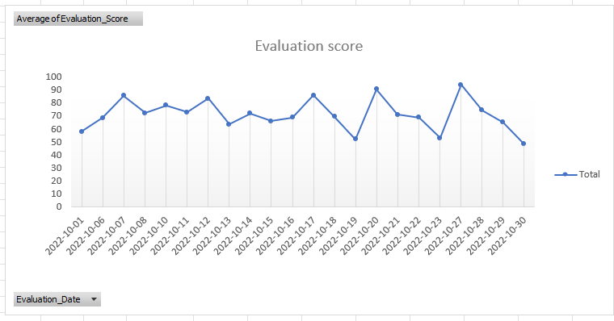
Performance Trends Over Time

Slide 14
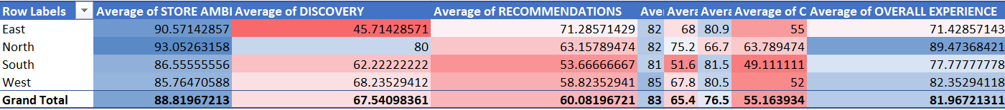
Breakdown by Evaluation Criteria

Slide 15
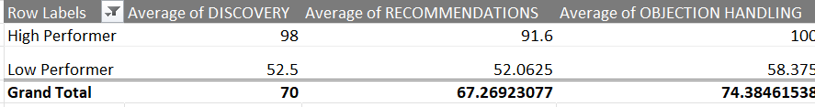
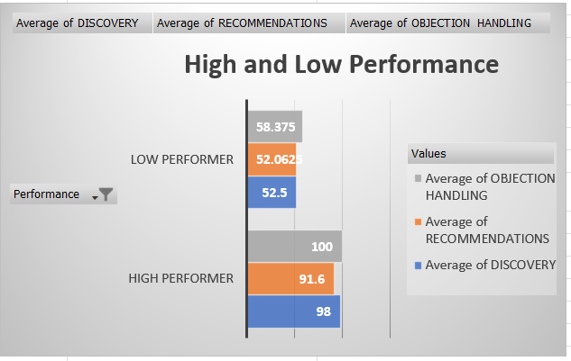
High vs. Low Performers Comparison

Slide 16
Regional Score Summary
The East zone emerges as the regional leader with the highest average evaluation scores and top proportion of high-performing stores, while other zones maintain stable baseline averages that occasionally mask internal performance gaps.
Emporal Trends
Time-series analysis via line graphs reveals how store evaluation scores fluctuate across the operational timeline, helping management pinpoint specific periods of consistency or decline.

Slide 17
Performance Distribution Analysis
Grading distribution shows that stores cluster across different tiers (High, Average, Low, and Bottom), highlighting where high performers excel and where vulnerable locations require immediate corrective action.

Slide 18
Recommendation
Suggested actions based on insights
Targeted Staff Training: Implement intensive coaching programs focusing on critical touchpoints like discovery, recommendations, and upsell techniques, particularly for stores falling into the low and bottom performance tiers.
Replicate East Zone Best Practices: Study the operational habits of top-performing locations in the leading East zone and share their successful customer service strategies with lagging regional branches.
Focus areas for improvement
Establish Continuous Monitoring: Use time-series trend lines and regular mystery shopping audits to track performance improvements month-over
month and catch dips in store execution early.
Focus on Closing Gaps: Direct management oversight toward locations with high performance variance, addressing internal gaps between top-tier scores and failing metrics to stabilize overall retail standards.

Slide 19
Conclusion
Based on the analysis, the management team will gain insights into the effectiveness of Style Advisors across different regions. The visualizations will provide a clear picture of performance trends, high-performing regions, and areas requiring attention. Recommendations can be made to enhance overall performance based on the identified strengths and weaknesses.

